Slide 1
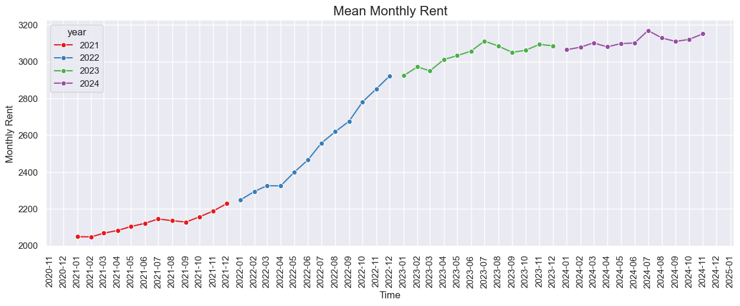
Spike in rent prices for HDB flats by 50% in 2022 due to post-Covid recovery and resumption of cross-border activities
Average rent of 3,000
Average rent of 2,000

Slide 2
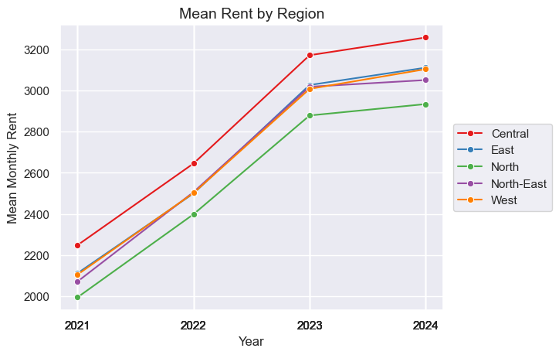
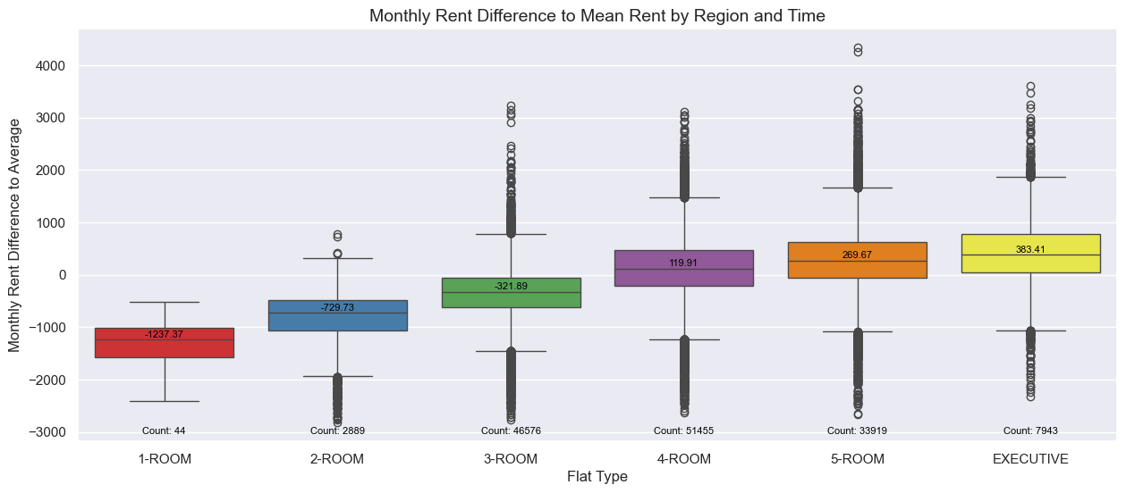
HDB flats in the Central region and larger flats continues to command the highest rent
270 above avg price
383 above avg price
120 above avg price
321 below avg price
729 below avg price
1,237 below avg price
Rent in the Central region is at least 200 (7%) higher than other regions while rent in the North region is around 200 (7%) below other region
Bigger increase in rent observed between the smaller flat types as compared to larger flat types

Slide 3
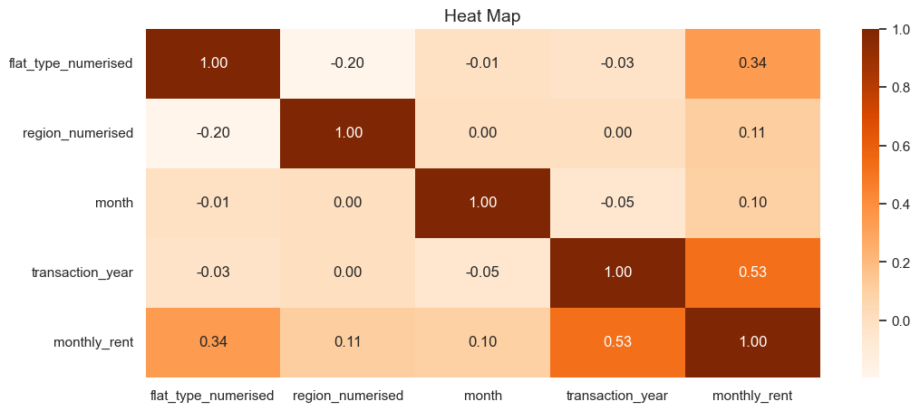
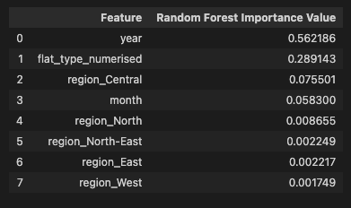
Machine learning model shows that year and flat type influence rental prices the most
 | 1 | 2 | 3 | 4 | 5 | 6
Flat Type | 1-Room | 2-Room | 3-Room | 4-Room | 5-Room | Executive
Region | North | North-East | West | East | Central
Both correlation plots and feature importance from Random Forest Regressor further confirm that year and flat type has the greatest impact on the rental prices.

